Slide 1
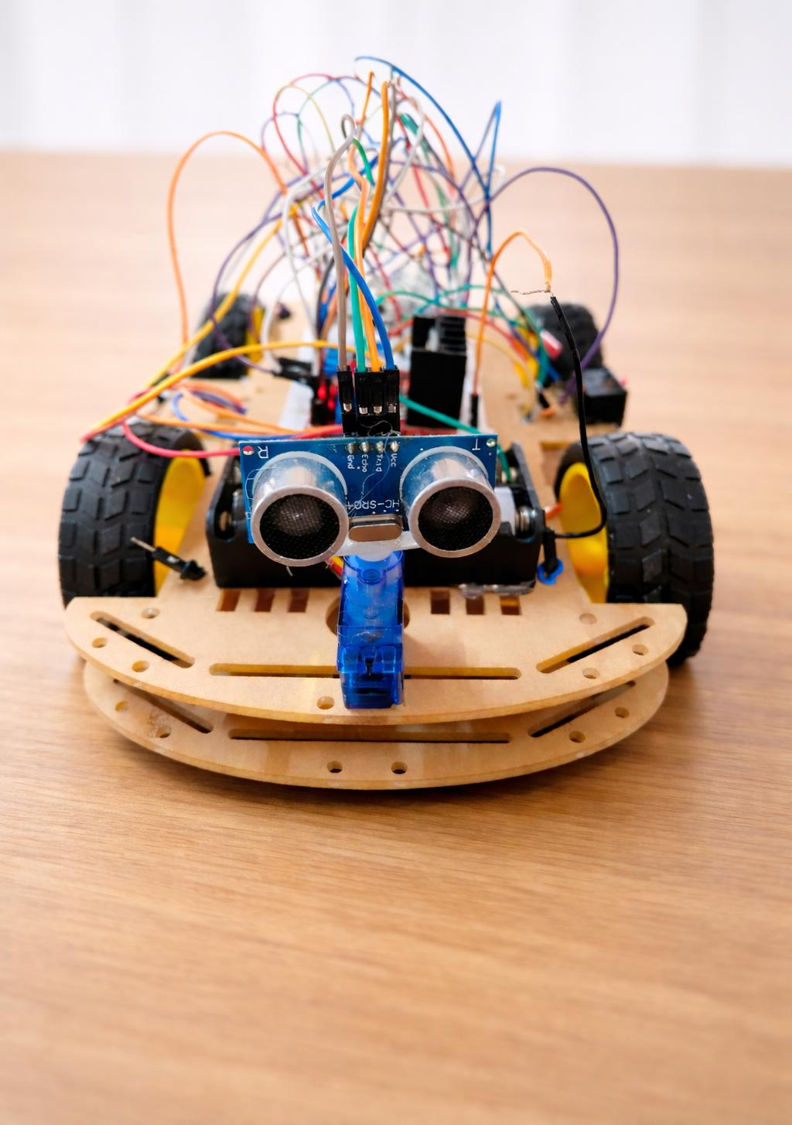
Smart navigation robotic vehicle
G. Prajna Sree Lakshmi
G. Pavani

Slide 2
Components
Arduino UNO – main controller and control unit
Ultrasonic Sensor (HC-SR04) - Obstacle distance detection
DC Gear Motors – Provide vehicle motion and torque
Motor Driver Module (L298N) - Control motor direction and speed
Batteries – Power supply for entire system
Battery holder – Holds and connects the batteries securely
Power Switch – Used to switch between autonomous mode and manual control mode
Wheels – Enables smooth robotic vehicle movements
Resistors – Reduces Arduino TX voltage for Bluetooth RX
Jumper Wires – Used for electrical entire connections
Breadboard – Allows, temporary, solder free circuit connections
Servo motor – Rotates ultrasonic sensor for scanning
Bluetooth module – Wireless communication for control movements
Chassis – Enables smooth robotic vehicle movements

Slide 3
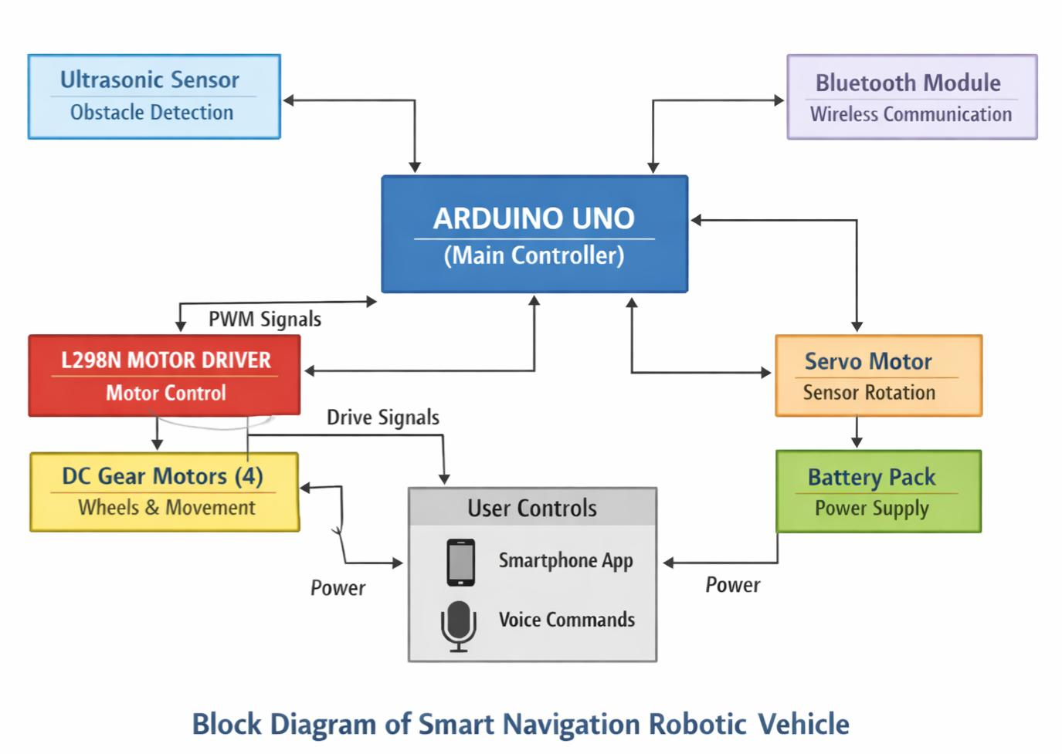
Working & circuit diagram
The robot is controlled by an Arduino UNO microcontroller.
It operates in Autonomous, Bluetooth, and Voice control modes.
The ultrasonic sensor continuously detects obstacles ahead.
On detecting an obstacle, the robot stops and scans left and right using a servo motor.
The controller selects the path with maximum free space for movement.
In Bluetooth and Voice modes, the robot moves based on user commands.
PWM motor control ensures smooth, stable, and safe navigation.

Slide 4
Applications
1.
Obstacle avoidance vehicles – Prototype for delivery robots or warehouse automation.
2.
Assistive robotics – Voice control enables hands-free operation for disabled or elderly.
3.
Warehouse & Factory Automation – Move materials around while avoiding obstacles and workers.
4.
Industrial Prototypes – Can be adapted for automated material transport in factories or workshops.
Search & Rescue in Hazardous Areas – Explore disaster zones where humans cannot go easily, avoiding debris.
5.
6.
Smart Agricultural Applications – Small-scale autonomous robot to transport seeds, fertilizers, or inspect fields
7.
Hospital Logistics – Deliver medicines, lab samples, or documents between rooms autonomously.

Slide 5





Future improvements
1
2
3
4
5
Autonomous Path Planning
Camera Integration
Advanced sensors
Mobile app control & Cloud Control
Enhanced
Voice control & AI integration

Slide 6
Advantages | Disadvantages
Automatic obstacle avoidance – Prevents collisions using sensors | Limited Bluetooth range – Bluetooth control works only within a short distance
Flexible control modes – Supports both automatic and manual control | Not suitable for rough surfaces– performance reduces on uneven ground
Expandable system – Can be upgraded with GPS, camera and IOT connectivity
Safe operation – Reduces human effort in risky environments
Real-Time monitoring – can be monitored on a smartphone in real time

Slide 7


